Slide 1
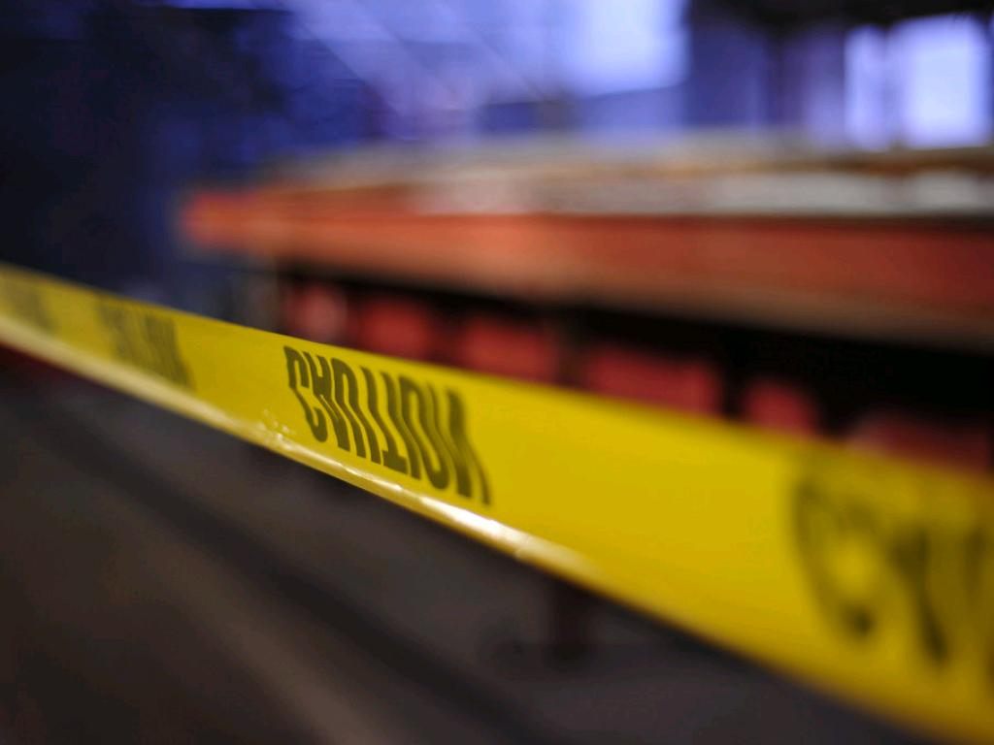
WHEN BAD THINGS HAPPEN
TO GOOD LIBRARIES
cc: nateOne - https://www.flickr.com/photos/49998984@N00

Slide 2
Julie Gonyou Mariam Hamou Susanna Hubbard Krimmer Hannah Rasmussen

Slide 3
PRESENTATION OVERVIEW
Disaster Planning 101
London PL’s “Catastrophic” Power Outage What happened? How we responded What did we do to recover long-term? Lessons learned!
Disaster Response & Recovery Planning

Slide 4
DISASTER PLANNING 101
Your Public Library
Be Prepared
Be Resilient:
Respond
Recover
Restore
Learn for the Future

Slide 5
BAD THINGS
Natural Hazards Floods/water Extreme Weather, e.g. blizzards, tornadoes, lightning Fire Earthquakes
Power and Energy Outages
Building System Failures, e.g. plumbing
Public Health Issues
Pests, e.g. bed bugs
Criminal Activity Violence, e.g. weapons, bomb threats
Arson
Cyber Attacks
Environmental Disasters, e.g. hazardous substances, mould

Slide 6
IMPACT
Service Disruption
Human Impact First Responders Public Employees
Library Assets Buildings & Property – structural & components, carpets
Collections, IT, furniture
Financial
Costs
Insurance
Loss of revenue

Slide 7
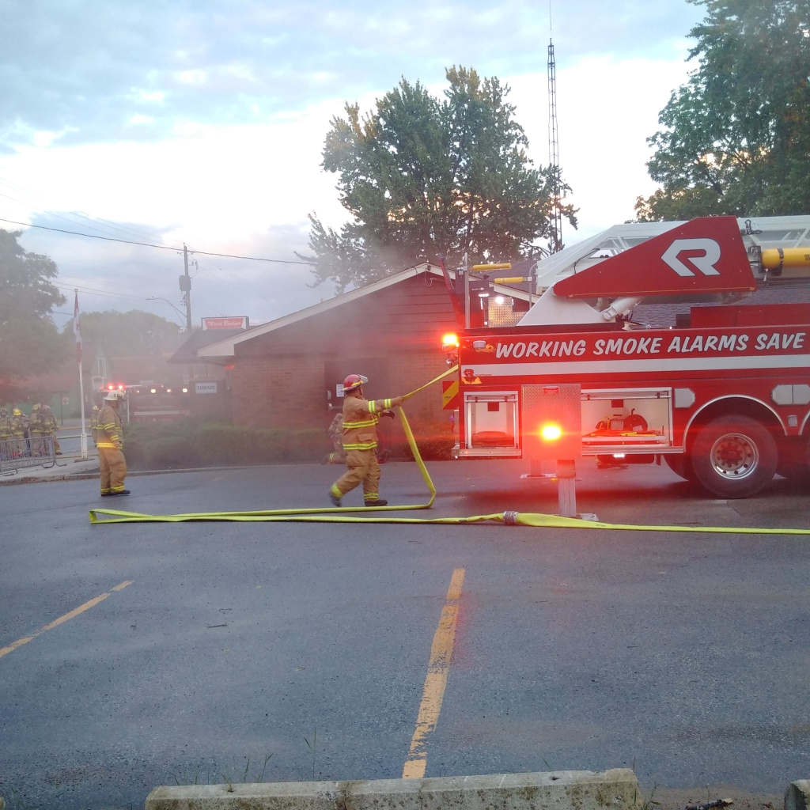
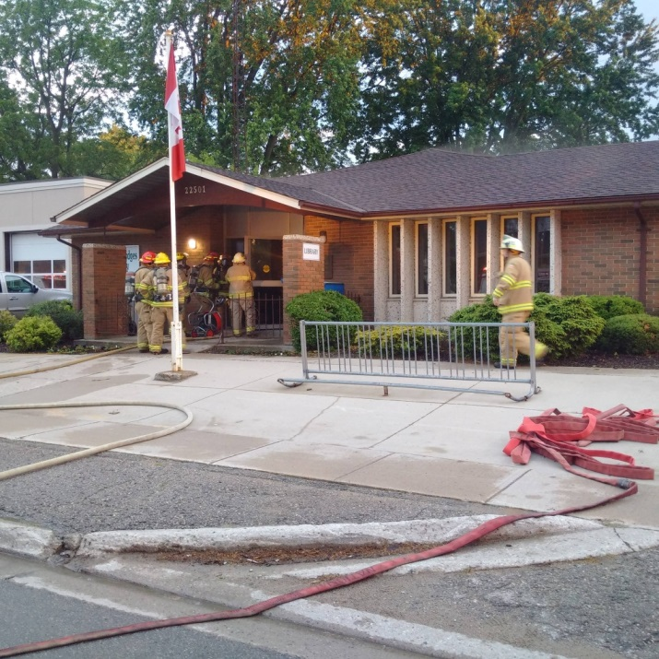
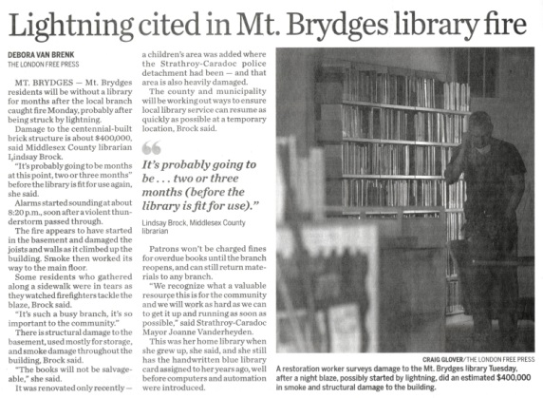
Middlesex County Library

Slide 8
BAD THINGS
Natural Hazards - Fire
What happened? How we responded What did we do to recover long-term?
Lessons learned!

Slide 9
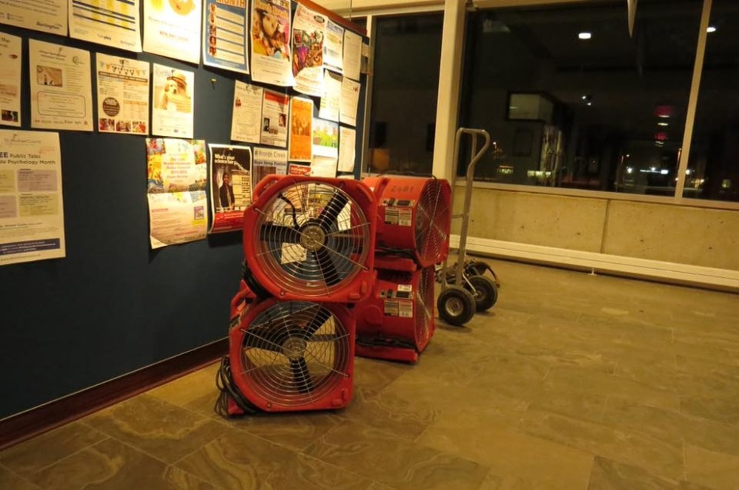
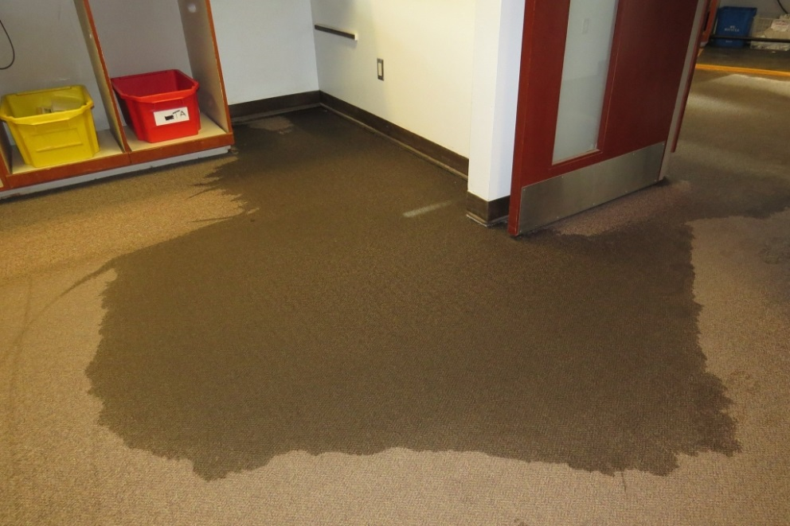
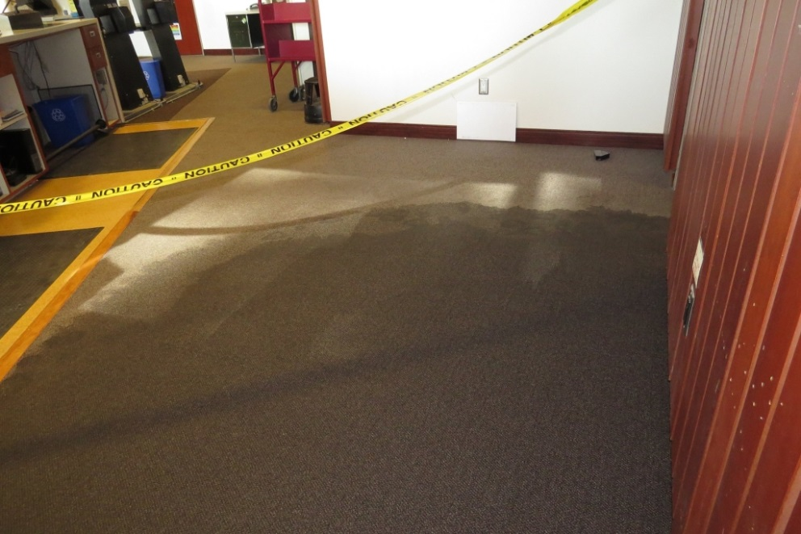
Burlington Public Library

Slide 10
BAD THINGS
Building System Failures – Sprinkler System
What happened? How we responded What did we do to recover long-term?
Lessons learned!

Slide 11
DISASTER PLANNING OBJECTIVES
Create a Disaster Response & Recovery Plan to:
Document the appropriate emergency responses and who has accountability for leadership & action
Create business continuity plan to ensure that essential services can be provided and operational tasks conducted after initial disruption
Facilitate the restoration of services and operations in as timely a manner as possible

Slide 12
MAJOR OBJECTIVES OF A DRP
Taken from IBM’s plan:
To minimize interruptions to the normal operations.
To limit the extent of disruption and damage.
To minimize the economic impact of the interruption.
To establish alternative means of operation in advance.
To train personnel with emergency procedures.
To provide for smooth and rapid restoration of service.
http://www.ibm.com/support

Slide 13
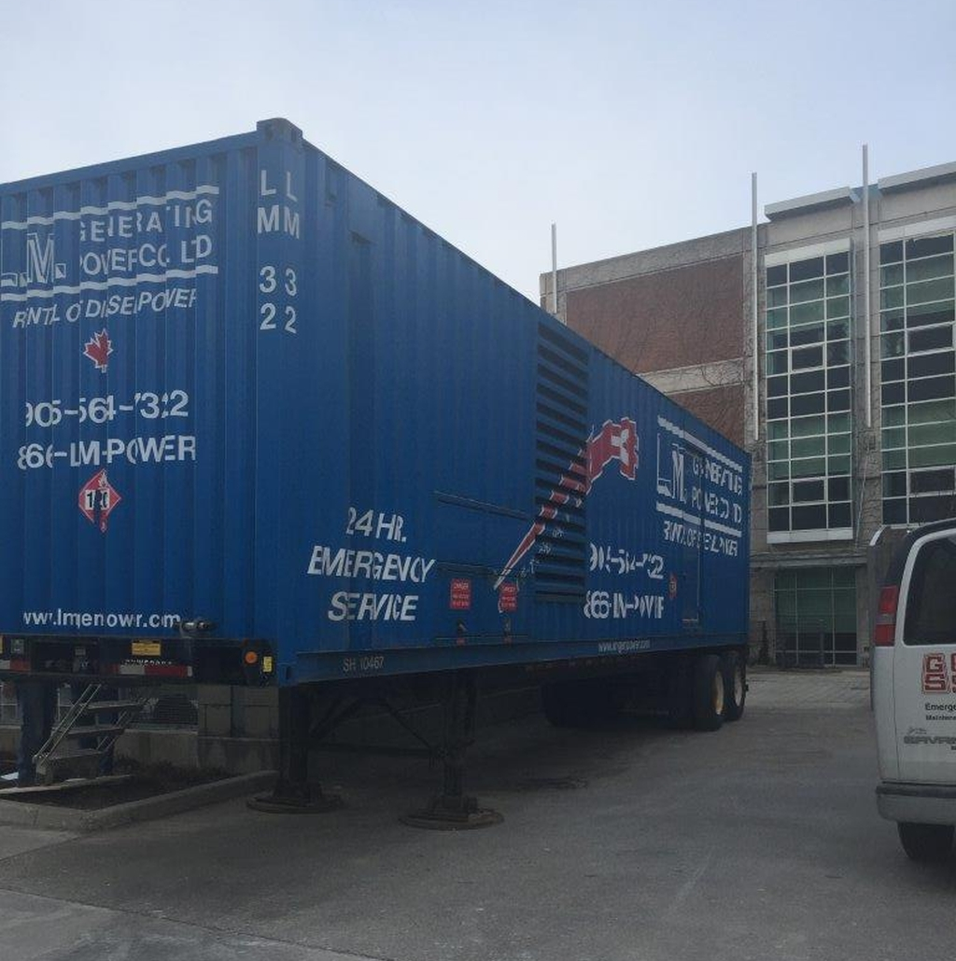
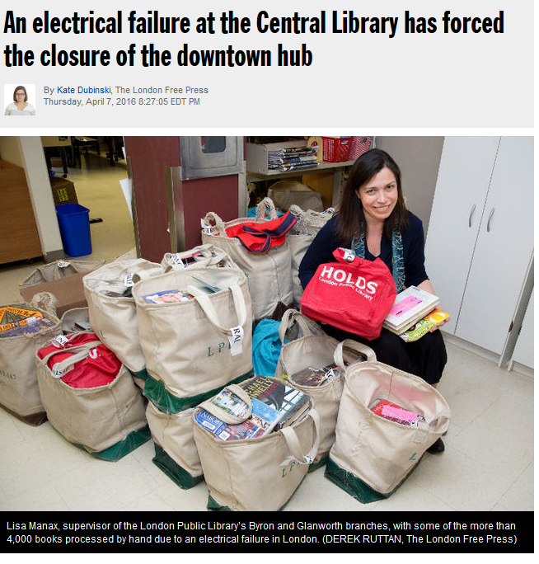
London Public Library

Slide 14
LONDON PUBLIC LIBRARY
“CATASTROPHIC” POWER OUTAGE
What happened? How we responded What did we do to recover long-term?
Lessons Learned!

Slide 15
LONDON PUBLIC LIBRARY
“CATASTROPHIC” POWER OUTAGE
What happened? Sudden and total power outage of the power supply to the Central Library
Central Library is the services & operations infrastructure hub for the system and a busy branch of 1m visits per year

Slide 16
HOW WE RESPONDED
TRIAGE ACTIONS
Closed Central immediately to determine scope of issue and possible solutions
Made staffing determinations for day one
Contacted staff and volunteers
Launched Crisis Communications Plan
Advised stakeholders, including tenants and III Sierra partners

Slide 17
HOW WE RESPONDED
TRIAGE ACTIONS
Worked with electrical contractors and City of London engineers to determine scope of problem
Tested a repair solution (not feasible)
Launched IT Disaster Recovery Plan Protocols

Slide 18
HOW WE RESPONDED
BUSINESS CONTINUITY ACTIONS
Worked with adjacent mall to establish a “Pop Up” Library to provide holds pick up, selected high demand collections
Moved IT operations to IT Disaster Recovery Site at a branch library
Moved Financial Services, inc. payroll, to IT Disaster Recovery Site
Redeployed employees to Pop Up and branches

Slide 19
HOW WE RESPONDED
BUSINESS CONTINUITY ACTIONS
Worked with City of London to restore system-wide VOIP phone services at branches via a branch
Moved all events/booked meetings to branch library locations
Changed hours of Friends of the Library Bookstore
Used a generator to provide power to Central to offer limited daily hours of service

Slide 20
HOW WE RESPONDED
RECOVERY ACTIONS
Replaced power supply from Central building to Hydro transformer
Transitioned back onto the power grid and hooked up Central emergency back up systems
Once power supply tested, moved IT and payroll functions back to Central
Resumed normal services operations

Slide 21
LONDON PUBLIC LIBRARY
“CATASTROPHIC” POWER OUTAGE
What did we do to recover long-term? Reviewed and revised IT Disaster Recovery Plan

Slide 22
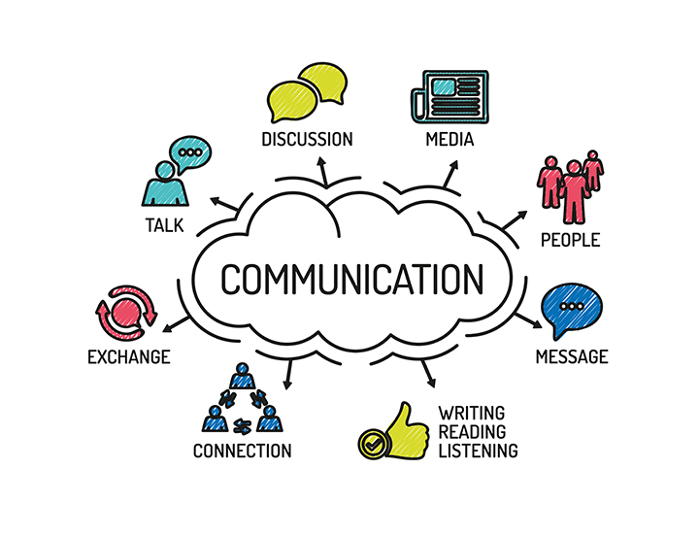
COMMUNICATIONS

Slide 23
HOW DID WE DO?
“Despite being a very difficult situation LPL staff have demonstrated such commitment to the needs of patrons, and what has impressed me the most is how much fun staff are having with going back to the “old school” method of loaning materials. I believe this has brought about an opportunity to remind patrons about how much library services have improved with the aid of technology… In my conversations with various members of the community it has been expressed to me that they are very satisfied with how LPL has reacted to the current situation and look forward to LPL resuming service. Thank you again to all members of LPL and City of London staff for their hard work during this power outage.”
Tanya Park, Councillor Ward 13

Slide 24
HOW DID WE DO?
Lucky with Library (Letter to the Editor - London Free Press)
Regarding the article Limited Services Monday at London’s Central Library (April 11). As a frequent London Public Library user I was most impressed recently when I went to the Central Branch to collect my holds. One would never know there had been a major service interruption last week. Library staff greeted me as usual at the circulation desk, my hold was ready for pickup, my account information was up to date despite last week’s IT troubles. Staff still face a mountain of items for sorting and re-shelving but to the outsider everything appears as efficient and organized as ever. I have experienced other library systems elsewhere and have always maintained that we Londoners are especially lucky with our London Public Library.
Karen Frank, London

Slide 25
LESSONS LEARNED
Keep in mind why this is important – inspiration comes from the people you serve
Have a Disaster Response & Recovery Plan in place
Have all copies of plans and key information available at a secure 24/7 location offsite
Know that all plans are general and you will need to be flexible to meet the specific situation

Slide 26
LESSONS LEARNED
Have a business continuity plan to offer service if possible, e.g. create “Pop Up” Library space(s)
Communications are essential!
Take advantage of your website/digital branch to communicate and offer service
Be mindful of the human response – public, employees, first responders

Slide 27
LESSONS LEARNED
Other municipal departments should be part of your planning and can help when disaster strikes
Your community will step up!
Other libraries can help in your recovery phase
Make sure your insurance is in order

Slide 28
Business Continuity Plan
Communications Plan
CODE RED Binder – Key Contacts
IT Disaster Recovery Plan
Employee Plan
Collections Recovery Plan
Emergency Procurement Policy
Records Management
Asset Inventory
Fire, evacuation & lockdown plans
DISASTER RESPONSE & RECOVERY PLAN

Slide 29
QUESTIONS?
hannah.rasmussen@lpl.ca
julie.gonyou@lpl.ca mariam.hamou@lpl.ca
susanna.krimmer@lpl.ca

